Slide 1
Fluxes for Model Comparisons
April 16, 2026

Slide 2
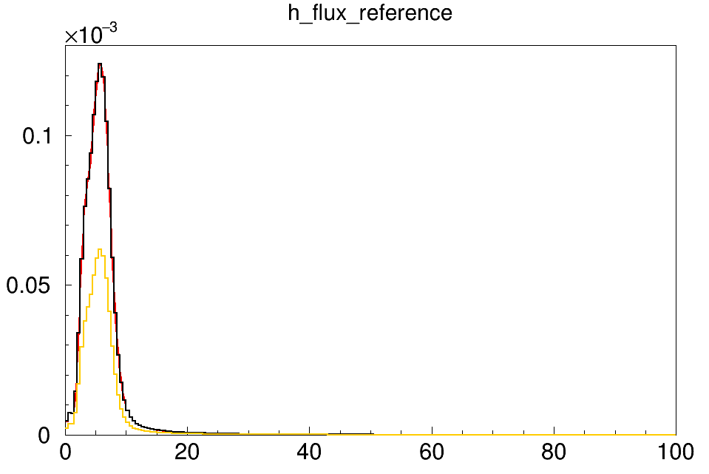
Comparison of FRW to Dan’s ME Flux
Dan’s flux: un-bin normalized (since nuisance divides out by bin width) and Dan’s flux is rebinned into 500 MeV bins
Red is the FRW flux (inherently bin width normalized)
Black is Dan’s flux bin width normalized
Orange is Dan’s flux
→ Perfect match essentially

Slide 3
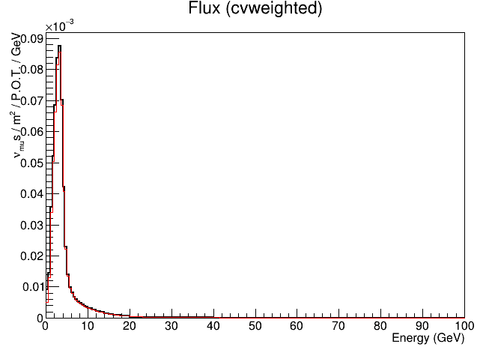
Comparison of FRW to Tutorial’s LE Flux
Black is the nu LE flux from FRW
Red is the LE flux from the tutorial: minerva_le_flux.root
For comparison, the red flux from the tutorlal is plotted after it has been bin width normalized (since it was the un-bin normalized flux) and it was scaled 1e-6 since it was per 10^6 POT
→ Perfect match essentially

Slide 4
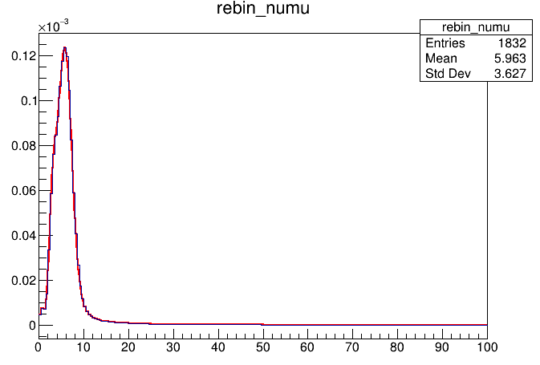
My own rebinning - ME, neutrino
FRW numu is red
My rebinned numu is black
Had to bin width normalize mine before plotting here since NUISANCE wants it NOT bin width normalized whereas the FRW flux is bin width normalized

Slide 5
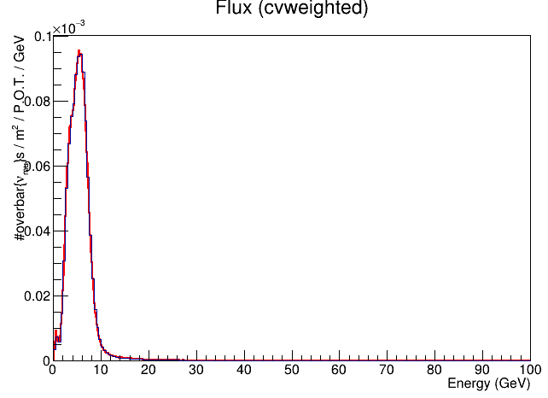
My own rebinning – ME, antineutrino
FRW numubar is red
My rebinned numubar is black
Had to bin width normalize mine before plotting here since NUISANCE wants it NOT bin width normalized whereas the FRW flux is bin width normalized

